Slide 1
Percentage
Percentage
Percentage, fraction and their equivalence
Base and Base change
Successive percentage change formula
Multiplication factor
Arrow method
Product based problems-
A. Mensuration
B. Expenditure based

Slide 2
Importance of this topic
Percentage is an important topic for all aptitude exams (including campus placement exams) because the knowledge of percentages helps us to easily understand and attempt problems from other areas in arithmetic.
Also, the understanding of percentages forms an important aspect of Data Interpretation (DI) in which questions require us to calculate percentage values, growth rates and the other percentage changes.
It is sued in almost all other topics of Quantitative Aptitude like – Profit and Loss, Simple and compound interest, Time and Work etc

Slide 3
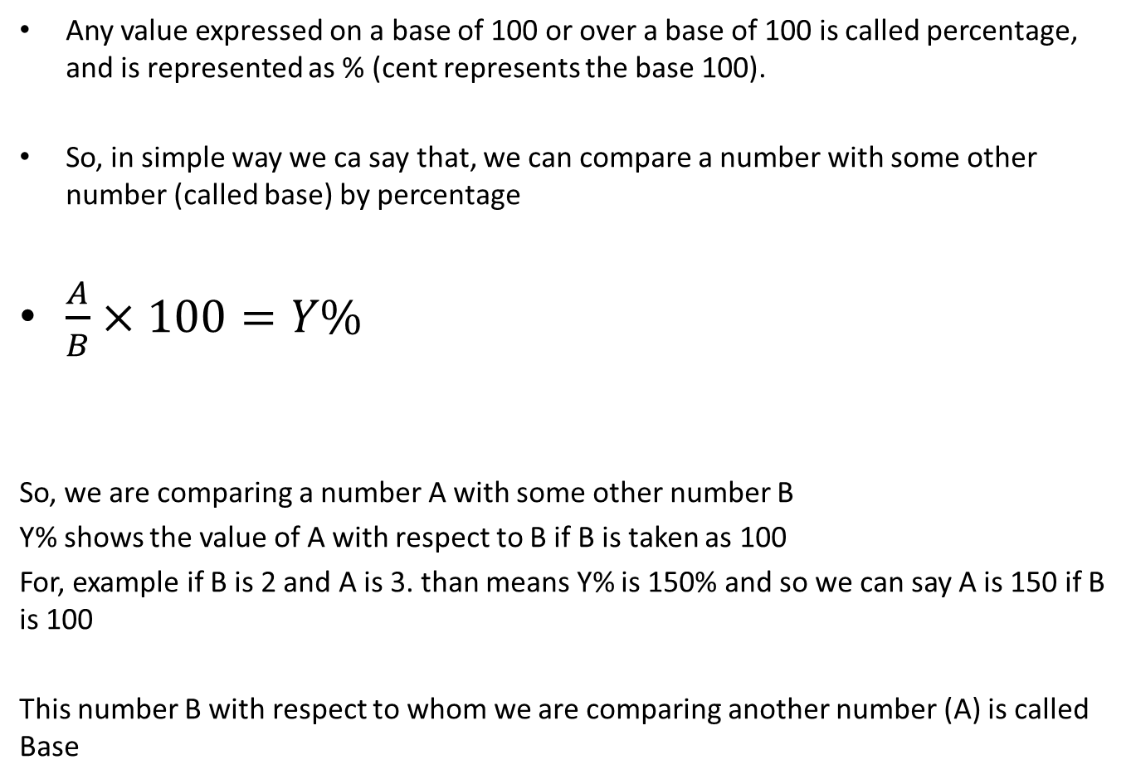

Meaning of percentage
Any value expressed on a base of 100 or over a base of 100 is called percentage, and is represented as % (cent represents the base 100).
So, in simple way we ca say that, we can compare a number with some other number (called base) by percentage
$\frac{A}{B}×100=Y\%$
So, we are comparing a number A with some other number B
Y% shows the value of A with respect to B if B is taken as 100
For, example if B is 2 and A is 3. than means Y% is 150% and so we can say A is 150 if B is 100
This number B with respect to whom we are comparing another number (A) is called Base

Slide 4
Percentage and fraction and their equivalence
A fraction is another way in which the value of a particular percentage can be represented. Therefore, one can say that percentages and fractions are equivalent and can be converted into one another as per the need.
As an example-
25% is same as 1/4,
33.33% is same as 1/3,
50% is same as 1/2 and so on.
1. To convert a percentage into a fraction, divide the percentage by 100. For example, 20% is same as 20/100 = 1/5.
2. Similarly, to convert a fraction into a percentage, multiply the fraction by 100. As an example, 2/5 = (2/5) × 100 = 40%.

Slide 5
Percentage Equivalent of Fractions
We need to know the percentage equivalent of fractions in order to enhance our understanding of percentages as a concept and to help in quick calculations.
For example, the percentage equivalent of 1/2 will be (1/2) × 100 = 50%. Instead of saying 1/2 or half of any value, we can also say that we are calculating 50% of the given value.
Let us look at some of these values.
1/2 = 50%, 1/3 = 33.33%, 1/4 = 25%, 1/5 = 20%, 1/6 = 16.66%,
1/8 = 12.5%, 1/9 = 11.11%, 1/10 = 10%, 1/15 = 6.66%, 1/20=5%
Important- If you double a number, the percentage increase is 100% and not 200%. Similarly if you triple a number, the percentage increase is 200% and not 300%, and so on.

Slide 6
Problems based on Percentage Equivalent of Fractions
There are mainly 3 types of problems which are based on Percentage Equivalent of Fractions –
1. Simplification
2. Approximations
3. Product based- Expenditure type (It will be discussed in the topic product based)

Slide 7
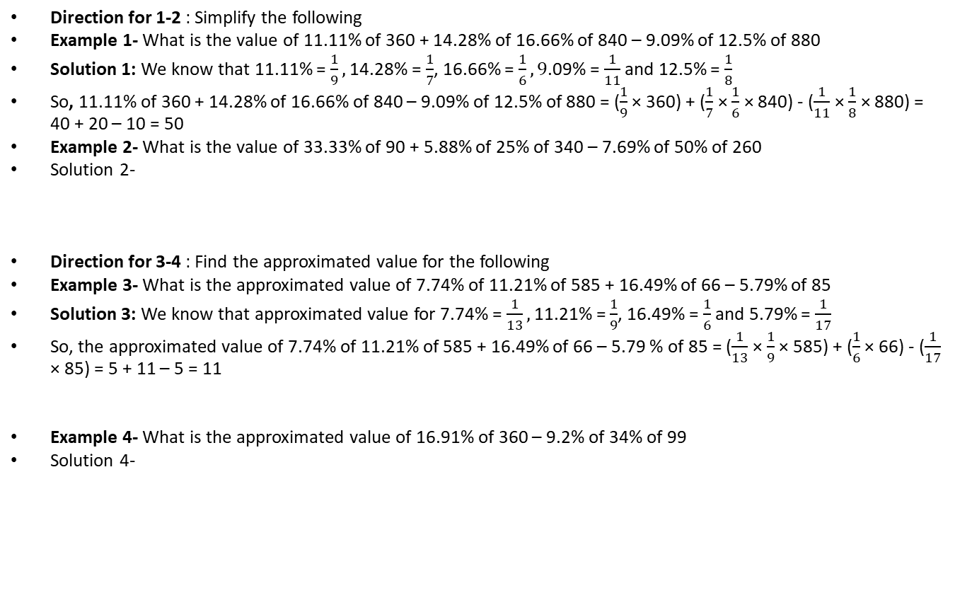
Problems based on Percentage Equivalent of Fractions
Direction for 1-2 : Simplify the following
Example 1- What is the value of 11.11% of 360 + 14.28% of 16.66% of 840 – 9.09% of 12.5% of 880
Solution 1: We know that 11.11% = $\frac{1}{9},$ 14.28% = $\frac{1}{7}$, 16.66% = $\frac{1}{6}, 9$.09% = $\frac{1}{11}$ and 12.5% = $\frac{1}{8}$
So, 11.11% of 360 + 14.28% of 16.66% of 840 – 9.09% of 12.5% of 880 = ($\frac{1}{9}$ × 360) + ($\frac{1}{7}$ × $\frac{1}{6}$ × 840) - ($\frac{1}{11}$ × $\frac{1}{8}$ × 880) = 40 + 20 – 10 = 50
Example 2- What is the value of 33.33% of 90 + 5.88% of 25% of 340 – 7.69% of 50% of 260
Solution 2-
Direction for 3-4 : Find the approximated value for the following
Example 3- What is the approximated value of 7.74% of 11.21% of 585 + 16.49% of 66 – 5.79% of 85
Solution 3: We know that approximated value for 7.74% = $\frac{1}{13},$ 11.21% = $\frac{1}{9}$, 16.49% = $\frac{1}{6}$and 5.79% = $\frac{1}{17}$
So, the approximated value of 7.74% of 11.21% of 585 + 16.49% of 66 – 5.79 % of 85 = ($\frac{1}{13}$ × $\frac{1}{9}$ × 585) + ($\frac{1}{6}$ × 66) - ($\frac{1}{17}$ × 85) = 5 + 11 – 5 = 11
Example 4- What is the approximated value of 16.91% of 360 – 9.2% of 34% of 99
Solution 4-

Slide 8
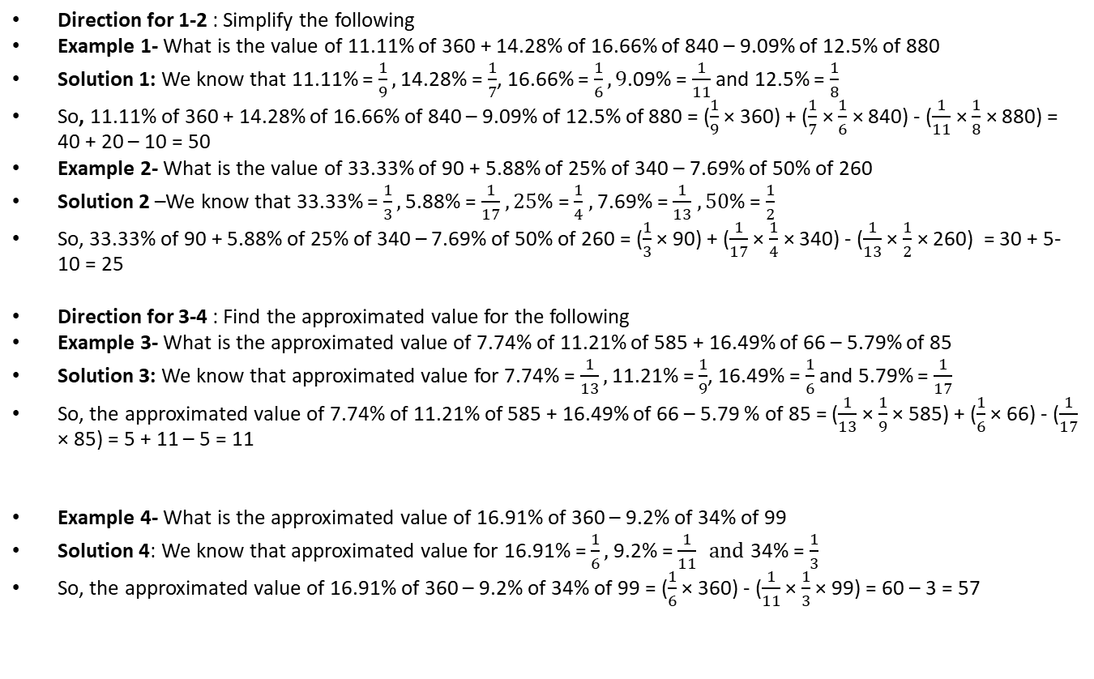
Problems based on Percentage Equivalent of Fractions
Direction for 1-2 : Simplify the following
Example 1- What is the value of 11.11% of 360 + 14.28% of 16.66% of 840 – 9.09% of 12.5% of 880
Solution 1: We know that 11.11% = $\frac{1}{9},$ 14.28% = $\frac{1}{7}$, 16.66% = $\frac{1}{6}, 9$.09% = $\frac{1}{11}$ and 12.5% = $\frac{1}{8}$
So, 11.11% of 360 + 14.28% of 16.66% of 840 – 9.09% of 12.5% of 880 = ($\frac{1}{9}$ × 360) + ($\frac{1}{7}$ × $\frac{1}{6}$ × 840) - ($\frac{1}{11}$ × $\frac{1}{8}$ × 880) = 40 + 20 – 10 = 50
Example 2- What is the value of 33.33% of 90 + 5.88% of 25% of 340 – 7.69% of 50% of 260
Solution 2 –We know that 33.33% = $\frac{1}{3},$ 5.88% = $\frac{1}{17}$ $, 25$% = $\frac{1}{4}$ $,$ 7.69% = $\frac{1}{13}$ $, 50$% = $\frac{1}{2}$
So, 33.33% of 90 + 5.88% of 25% of 340 – 7.69% of 50% of 260 = ($\frac{1}{3}$ × 90) + ($\frac{1}{17}$ × $\frac{1}{4}$ × 340) - ($\frac{1}{13}$ × $\frac{1}{2}$ × 260) = 30 + 5-10 = 25
Direction for 3-4 : Find the approximated value for the following
Example 3- What is the approximated value of 7.74% of 11.21% of 585 + 16.49% of 66 – 5.79% of 85
Solution 3: We know that approximated value for 7.74% = $\frac{1}{13},$ 11.21% = $\frac{1}{9}$, 16.49% = $\frac{1}{6}$and 5.79% = $\frac{1}{17}$
So, the approximated value of 7.74% of 11.21% of 585 + 16.49% of 66 – 5.79 % of 85 = ($\frac{1}{13}$ × $\frac{1}{9}$ × 585) + ($\frac{1}{6}$ × 66) - ($\frac{1}{17}$ × 85) = 5 + 11 – 5 = 11
Example 4- What is the approximated value of 16.91% of 360 – 9.2% of 34% of 99
Solution 4: We know that approximated value for 16.91% = $\frac{1}{6},$ 9.2% = $\frac{1}{11} and$ 34% = $\frac{1}{3}$
So, the approximated value of 16.91% of 360 – 9.2% of 34% of 99 = ($\frac{1}{6}$ × 360) - ($\frac{1}{11}$ × $\frac{1}{3}$ × 99) = 60 – 3 = 57

Slide 9
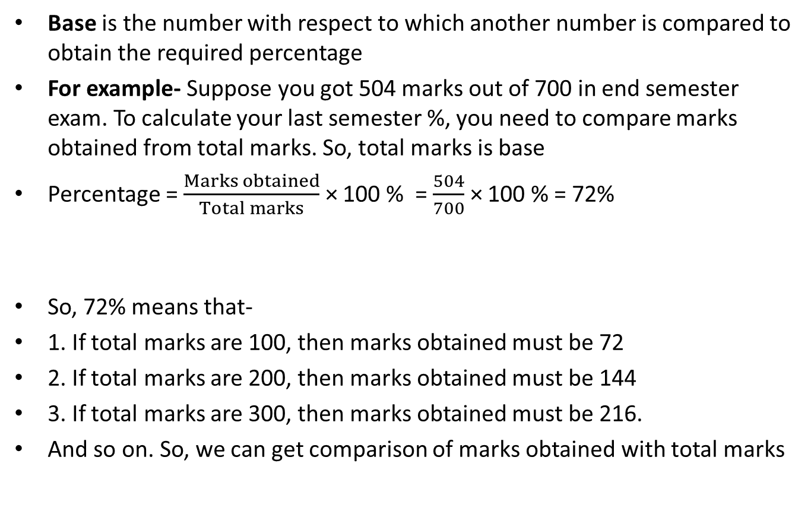

Base and Base change
Base is the number with respect to which another number is compared to obtain the required percentage
For example- Suppose you got 504 marks out of 700 in end semester exam. To calculate your last semester %, you need to compare marks obtained from total marks. So, total marks is base
Percentage = $\frac{Marks obtained}{Total marks}$ × 100 % = $\frac{504}{700}$ × 100 % = 72%
So, 72% means that-
1. If total marks are 100, then marks obtained must be 72
2. If total marks are 200, then marks obtained must be 144
3. If total marks are 300, then marks obtained must be 216.
And so on. So, we can get comparison of marks obtained with total marks

Slide 10
Base Change
Base change involves 2 situations-
1. Base change due to successive changes
Example- The price of rice increased by 25% in the month of October and then increased by 20% in November. If the price was Rs. 40/kg in September, what is the price in December?
Solution- Initially price was Rs. 40/kg. It is increased by 25% in 1st month and so price after 25% increase is Rs. 50/kg. So, for the 1st increase the base was Rs. 40/kg. But, for 2nd month’s increase in price, the base is new value i.e. Rs. 50/kg and not the older value (i.e. Rs. 40/kg)
So, in November the rate is 20% more than rate in October =Rs. 50/kg + 20% of Rs. 50/kg = Rs. 60/kg
2. Base change due to change of number and base
If A and B are 2 numbers we can compare- A by B, B by A, A-B by B, A-B by A (if A>B)
Initially we compare A with B (base). In next case, we compare B by A or B-A by A or A-B by B
Example- If A got 20% more votes than B in an election then find –
A. By what % is B’s votes less than that received by A?
B. The votes obtained by A is what % of votes obtained by B?
C. The votes obtained by B is what % of votes obtained by A?
Solution- Let B got 100 votes and so A got 120 votes.
We know that A-B is 20% more than B. now we need to compare- A-B by A, A by B and B by A
3. Base change in expenditure based problems (will be discussed later)

Slide 11
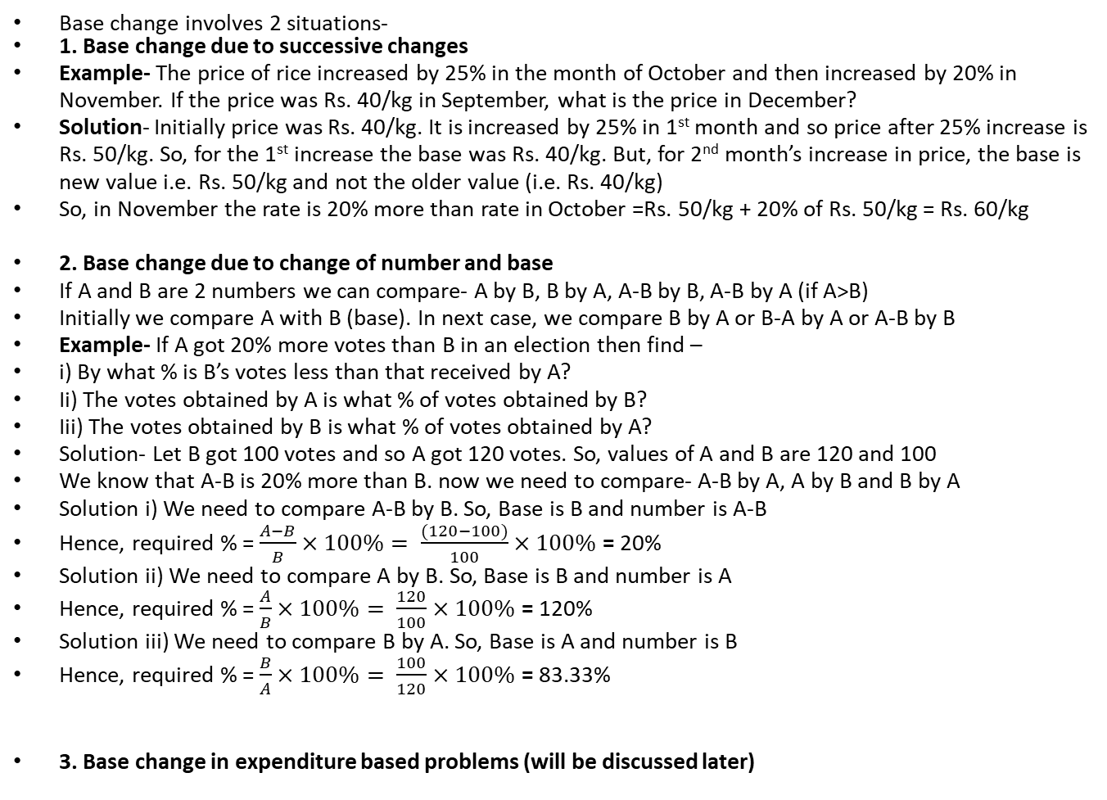
Base Change
Base change involves 2 situations-
1. Base change due to successive changes
Example- The price of rice increased by 25% in the month of October and then increased by 20% in November. If the price was Rs. 40/kg in September, what is the price in December?
Solution- Initially price was Rs. 40/kg. It is increased by 25% in 1st month and so price after 25% increase is Rs. 50/kg. So, for the 1st increase the base was Rs. 40/kg. But, for 2nd month’s increase in price, the base is new value i.e. Rs. 50/kg and not the older value (i.e. Rs. 40/kg)
So, in November the rate is 20% more than rate in October =Rs. 50/kg + 20% of Rs. 50/kg = Rs. 60/kg
2. Base change due to change of number and base
If A and B are 2 numbers we can compare- A by B, B by A, A-B by B, A-B by A (if A>B)
Initially we compare A with B (base). In next case, we compare B by A or B-A by A or A-B by B
Example- If A got 20% more votes than B in an election then find –
i) By what % is B’s votes less than that received by A?
Ii) The votes obtained by A is what % of votes obtained by B?
Iii) The votes obtained by B is what % of votes obtained by A?
Solution- Let B got 100 votes and so A got 120 votes. So, values of A and B are 120 and 100
We know that A-B is 20% more than B. now we need to compare- A-B by A, A by B and B by A
Solution i) We need to compare A-B by B. So, Base is B and number is A-B
Hence, required % = $\frac{A−B}{B}×100\%= \frac{(120−100)}{100}×100\%$ = 20%
Solution ii) We need to compare A by B. So, Base is B and number is A
Hence, required % = $\frac{A}{B}×100\%= \frac{120}{100}×100\%$ = 120%
Solution iii) We need to compare B by A. So, Base is A and number is B
Hence, required % = $\frac{B}{A}×100\%= \frac{100}{120}×100\%$ = 83.33%
3. Base change in expenditure based problems (will be discussed later)

Slide 12
1. By what % is 30% of 50% of a number more than 45% of 20% of the sane Number?
Both are Equal b. 6% c. 66.66% d. 40%
2. In a family, the Father ate half of a Cake while the remaining half was divided equally among the 4 children. By what % was the Father’s share more than any of the children’s share?
200% b. 400% c. 300% d. 100%
3. If 50% of a number is more than 1/5th of the number by 150, then what will be the value of the difference between the number and 30% of the number?
350 b. 150 c. 500 d. None of These
4. By what % is 50% of a number more or less than 60% of half the number?
33.33% b. 66.66% c. 25% d. 40%
5. If A got 8.33% more votes than B in an election, by what % is B’s votes less than that received by A?
a. 7.71% b. 8.33% c. 9.09% d. 10%
6. The average temperature for the month of July was 18 degrees while the average temperature for the month of August was 22 degrees. By how many percentage was the average temperature in August more than that in July?
a. 4 % b. 22.22% c. 20% d. Cannot be Determined

Slide 13
1. By what % is 30% of 50% of a number more than 45% of 20% of the sane number?
a. Both are Equal b. 6% c. 66.66% d. 40%
Solution 1:
2. In a family, the Father ate half of a Cake while the remaining half was divided equally among the 4 children. By what % was the Father’s share more than any of the children’s share?
a. 200% b. 400% c. 300% d. 100%
Solution 2:

Slide 14
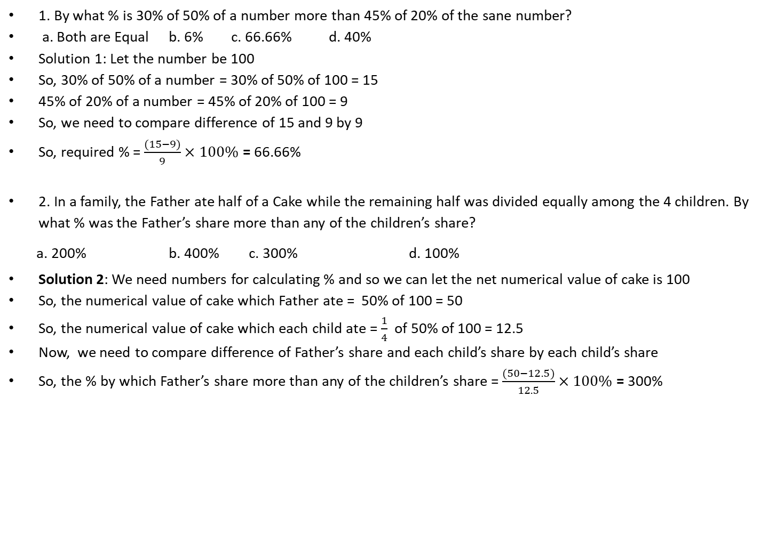
1. By what % is 30% of 50% of a number more than 45% of 20% of the sane number?
a. Both are Equal b. 6% c. 66.66% d. 40%
Solution 1: Let the number be 100
So, 30% of 50% of a number = 30% of 50% of 100 = 15
45% of 20% of a number = 45% of 20% of 100 = 9
So, we need to compare difference of 15 and 9 by 9
So, required % = $\frac{(15−9)}{9}×100\%$ = 66.66%
2. In a family, the Father ate half of a Cake while the remaining half was divided equally among the 4 children. By what % was the Father’s share more than any of the children’s share?
a. 200% b. 400% c. 300% d. 100%
Solution 2: We need numbers for calculating % and so we can let the net numerical value of cake is 100
So, the numerical value of cake which Father ate = 50% of 100 = 50
So, the numerical value of cake which each child ate = $\frac{1}{4}$ of 50% of 100 = 12.5
Now, we need to compare difference of Father’s share and each child’s share by each child’s share
So, the % by which Father’s share more than any of the children’s share = $\frac{(50−12.5)}{12.5}×100\%$ = 300%

Slide 15
3. If 50% of a number is more than 1/5th of the number by 150, then what will be the value of the difference between the number and 30% of the number?
a. 350 b. 150 c. 500 d. None of These
Solution 3:
4. By what % is 50% of a number more or less than 60% of half the number?
a. 33.33% b. 66.66% c. 25% d. 40%
Solution 4:

Slide 16
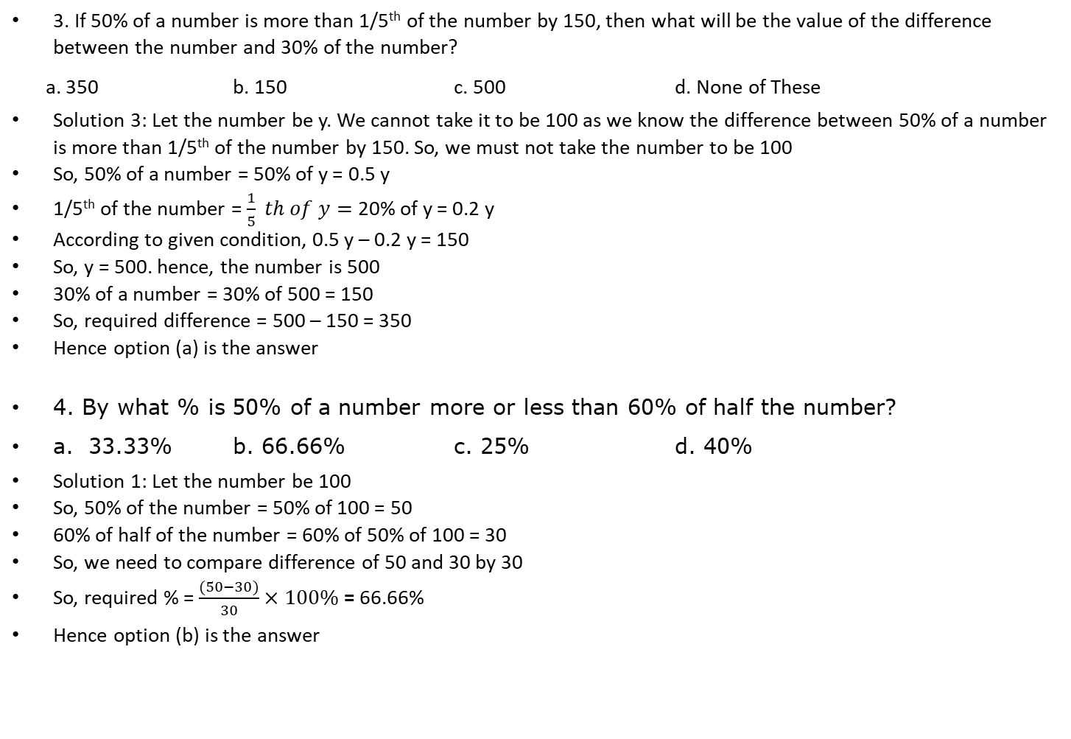
3. If 50% of a number is more than 1/5th of the number by 150, then what will be the value of the difference between the number and 30% of the number?
a. 350 b. 150 c. 500 d. None of These
Solution 3: Let the number be y. We cannot take it to be 100 as we know the difference between 50% of a number is more than 1/5th of the number by 150. So, we must not take the number to be 100
So, 50% of a number = 50% of y = 0.5 y
1/5th of the number = $\frac{1}{5} th of y=$20% of y = 0.2 y
According to given condition, 0.5 y – 0.2 y = 150
So, y = 500. hence, the number is 500
30% of a number = 30% of 500 = 150
So, required difference = 500 – 150 = 350
Hence option (a) is the answer
4. By what % is 50% of a number more or less than 60% of half the number?
a. 33.33% b. 66.66% c. 25% d. 40%
Solution 1: Let the number be 100
So, 50% of the number = 50% of 100 = 50
60% of half of the number = 60% of 50% of 100 = 30
So, we need to compare difference of 50 and 30 by 30
So, required % = $\frac{(50−30)}{30}×100\%$ = 66.66%
Hence option (b) is the answer

Slide 17
5. If A got 8.33% more votes than B in an election, by what % is B’s votes less than that received by A?
a. 7.71% b. 8.33% c. 9.09% d. 10%
Solution 5:
6. The average temperature for the month of July was 18 degrees while the average temperature for the month of August was 22 degrees. By how many percentage was the average temperature in August more than that in July?
a. 4 % b. 22.22% c. 20% d. Cannot be Determined
Solution 6:

Slide 18
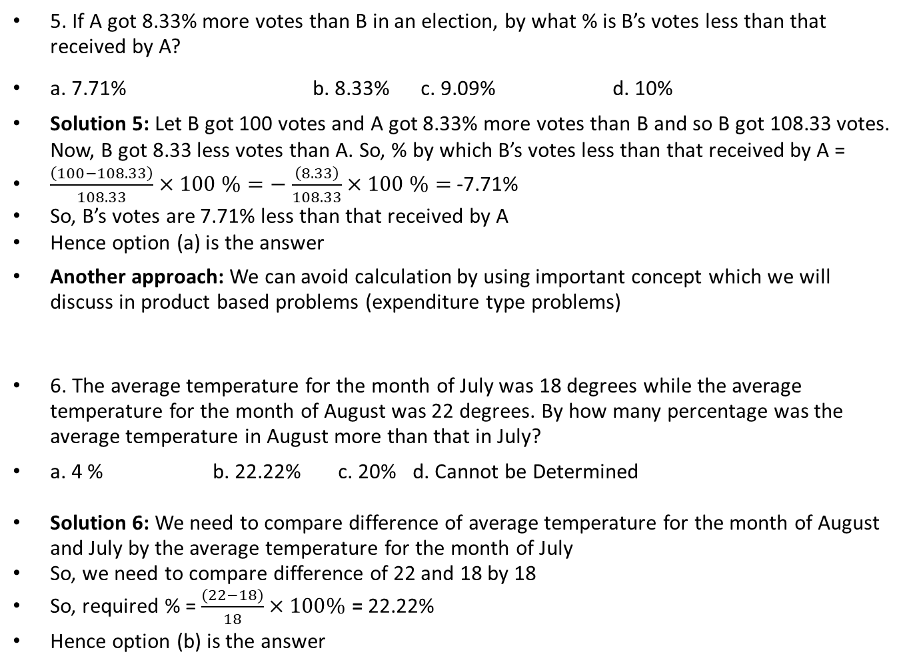
5. If A got 8.33% more votes than B in an election, by what % is B’s votes less than that received by A?
a. 7.71% b. 8.33% c. 9.09% d. 10%
Solution 5: Let B got 100 votes and A got 8.33% more votes than B and so B got 108.33 votes. Now, B got 8.33 less votes than A. So, % by which B’s votes less than that received by A =
$\frac{\left(100−108.33\right)}{108.33}×100 \%=−$ $\frac{\left(8.33\right)}{108.33}×100 \%=$ -7.71%
So, B’s votes are 7.71% less than that received by A
Hence option (a) is the answer
Another approach: We can avoid calculation by using important concept which we will discuss in product based problems (expenditure type problems)
6. The average temperature for the month of July was 18 degrees while the average temperature for the month of August was 22 degrees. By how many percentage was the average temperature in August more than that in July?
a. 4 % b. 22.22% c. 20% d. Cannot be Determined
Solution 6: We need to compare difference of average temperature for the month of August and July by the average temperature for the month of July
So, we need to compare difference of 22 and 18 by 18
So, required % = $\frac{(22−18)}{18}×100\%$ = 22.22%
Hence option (b) is the answer

Slide 19
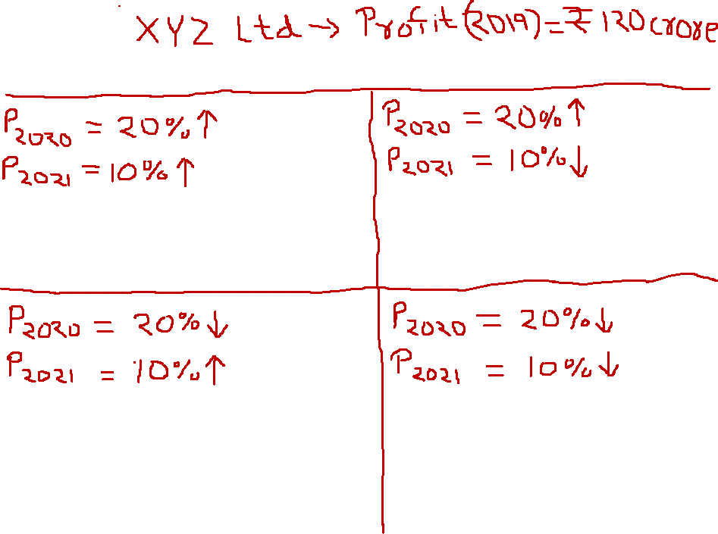
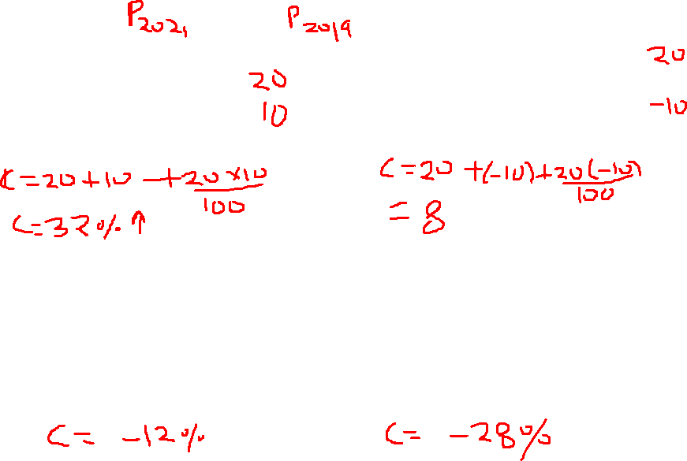

Slide 20
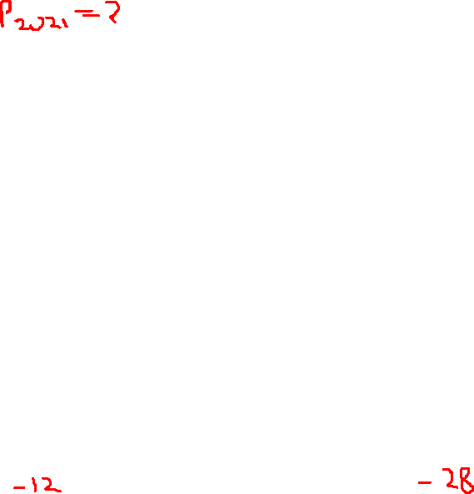
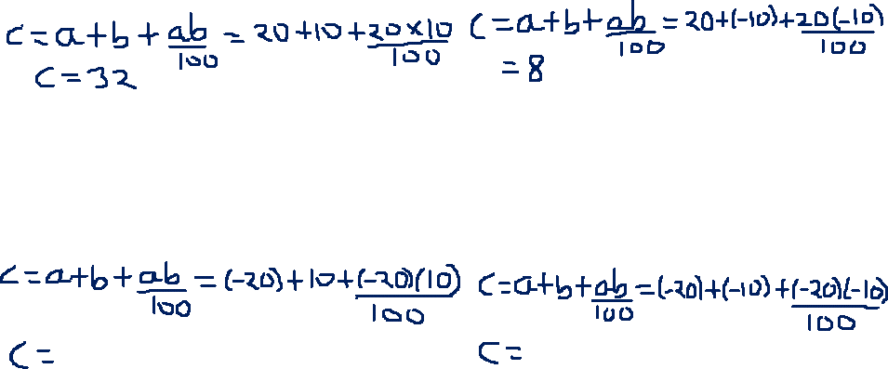

Slide 21
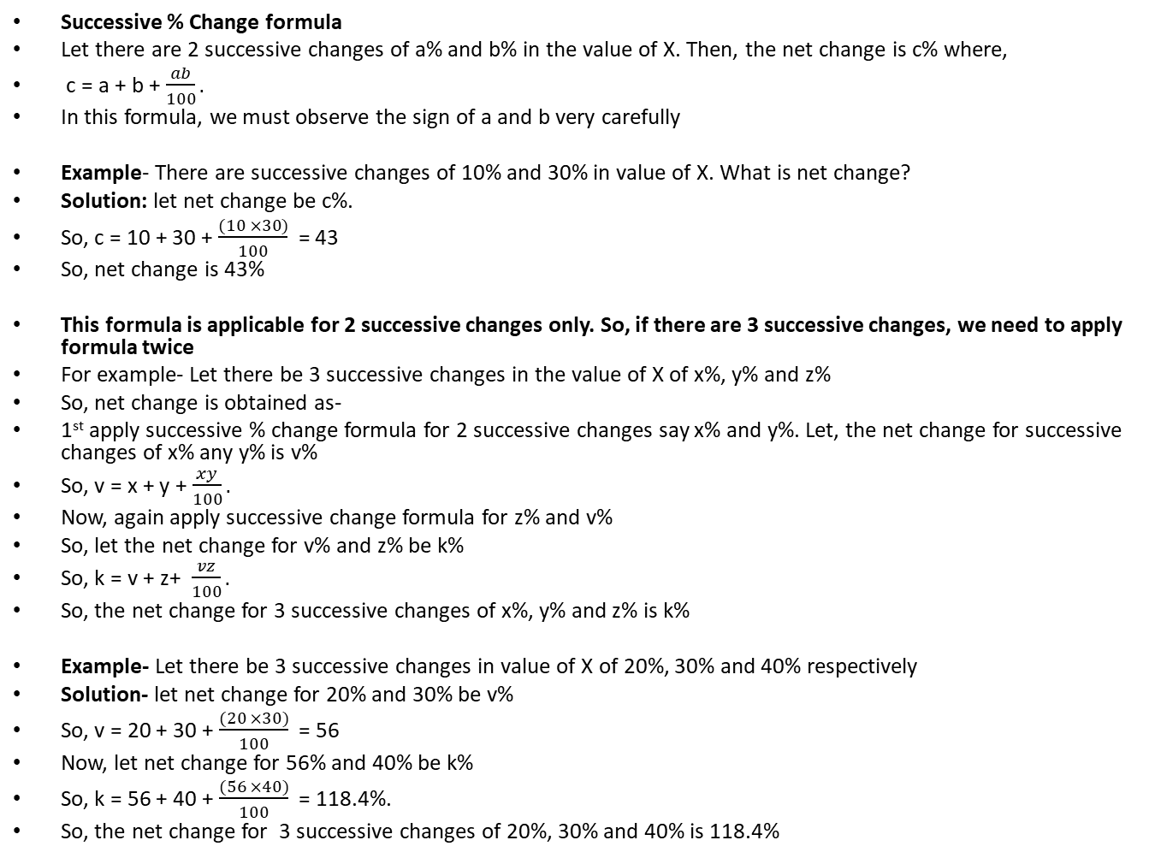
Successive percentage change formula
Successive % Change formula
Let there are 2 successive changes of a% and b% in the value of X. Then, the net change is c% where,
c = a + b + $\frac{ab}{100}.$
In this formula, we must observe the sign of a and b very carefully
Example- There are successive changes of 10% and 30% in value of X. What is net change?
Solution: let net change be c%.
So, c = 10 + 30 + $\frac{(10 ×30)}{100}$ = 43
So, net change is 43%
This formula is applicable for 2 successive changes only. So, if there are 3 successive changes, we need to apply formula twice
For example- Let there be 3 successive changes in the value of X of x%, y% and z%
So, net change is obtained as-
1st apply successive % change formula for 2 successive changes say x% and y%. Let, the net change for successive changes of x% any y% is v%
So, v = x + y + $\frac{xy}{100}.$
Now, again apply successive change formula for z% and v%
So, let the net change for v% and z% be k%
So, k = v + z+ $\frac{vz}{100}.$
So, the net change for 3 successive changes of x%, y% and z% is k%
Example- Let there be 3 successive changes in value of X of 20%, 30% and 40% respectively
Solution- let net change for 20% and 30% be v%
So, v = 20 + 30 + $\frac{(20 ×30)}{100}$ = 56
Now, let net change for 56% and 40% be k%
So, k = 56 + 40 + $\frac{(56 ×40)}{100}$ = 118.4%.
So, the net change for 3 successive changes of 20%, 30% and 40% is 118.4%

Slide 22
Let the profit of company XYZ Ltd. was Rs. 120 crore in year 2018. What is the profit in 2020 if-
A. Profit was increased by 20% in 2019 and increased by 10% in 2020?
B. Profit was increased by 20% in 2019 and decreased by 10% in 2020?
C. Profit was decreased by 20% in 2019 and increased by 10% in 2020?
D. Profit was decreased by 20% in 2019 and decreased by 10% in 2020?
Solution- In all these problems the changes are 20% and 10% but we need to be very cautious about the signs of these changes (+ve or –ve)

Slide 23
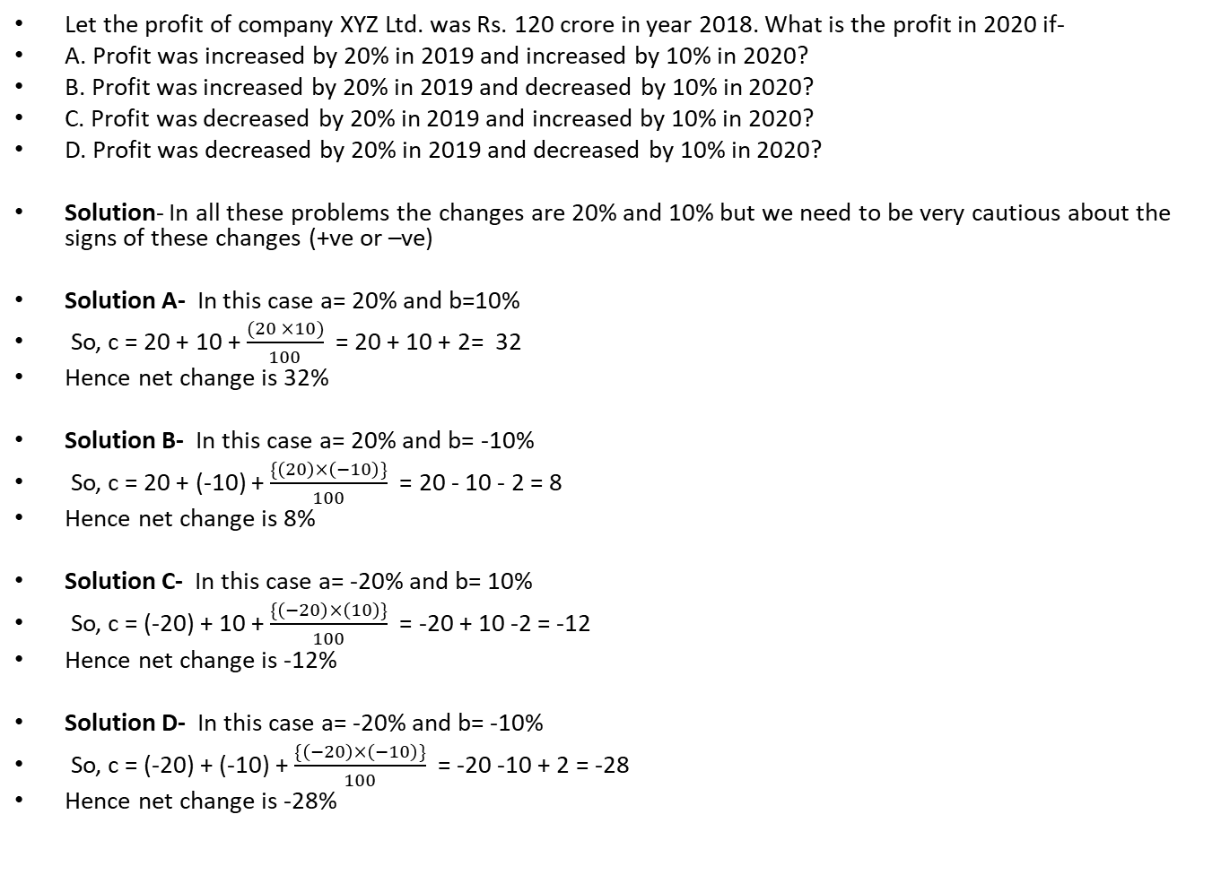
Let the profit of company XYZ Ltd. was Rs. 120 crore in year 2018. What is the profit in 2020 if-
A. Profit was increased by 20% in 2019 and increased by 10% in 2020?
B. Profit was increased by 20% in 2019 and decreased by 10% in 2020?
C. Profit was decreased by 20% in 2019 and increased by 10% in 2020?
D. Profit was decreased by 20% in 2019 and decreased by 10% in 2020?
Solution- In all these problems the changes are 20% and 10% but we need to be very cautious about the signs of these changes (+ve or –ve)
Solution A- In this case a= 20% and b=10%
So, c = 20 + 10 + $\frac{(20 ×10)}{100}$ = 20 + 10 + 2= 32
Hence net change is 32%
Solution B- In this case a= 20% and b= -10%
So, c = 20 + (-10) + $\frac{\{\left(20\right)×\left(−10\right)\}}{100}$ = 20 - 10 - 2 = 8
Hence net change is 8%
Solution C- In this case a= -20% and b= 10%
So, c = (-20) + 10 + $\frac{\{\left(−20\right)×\left(10\right)\}}{100}$ = -20 + 10 -2 = -12
Hence net change is -12%
Solution D- In this case a= -20% and b= -10%
So, c = (-20) + (-10) + $\frac{\{\left(−20\right)×\left(−10\right)\}}{100}$ = -20 -10 + 2 = -28
Hence net change is -28%

Slide 24
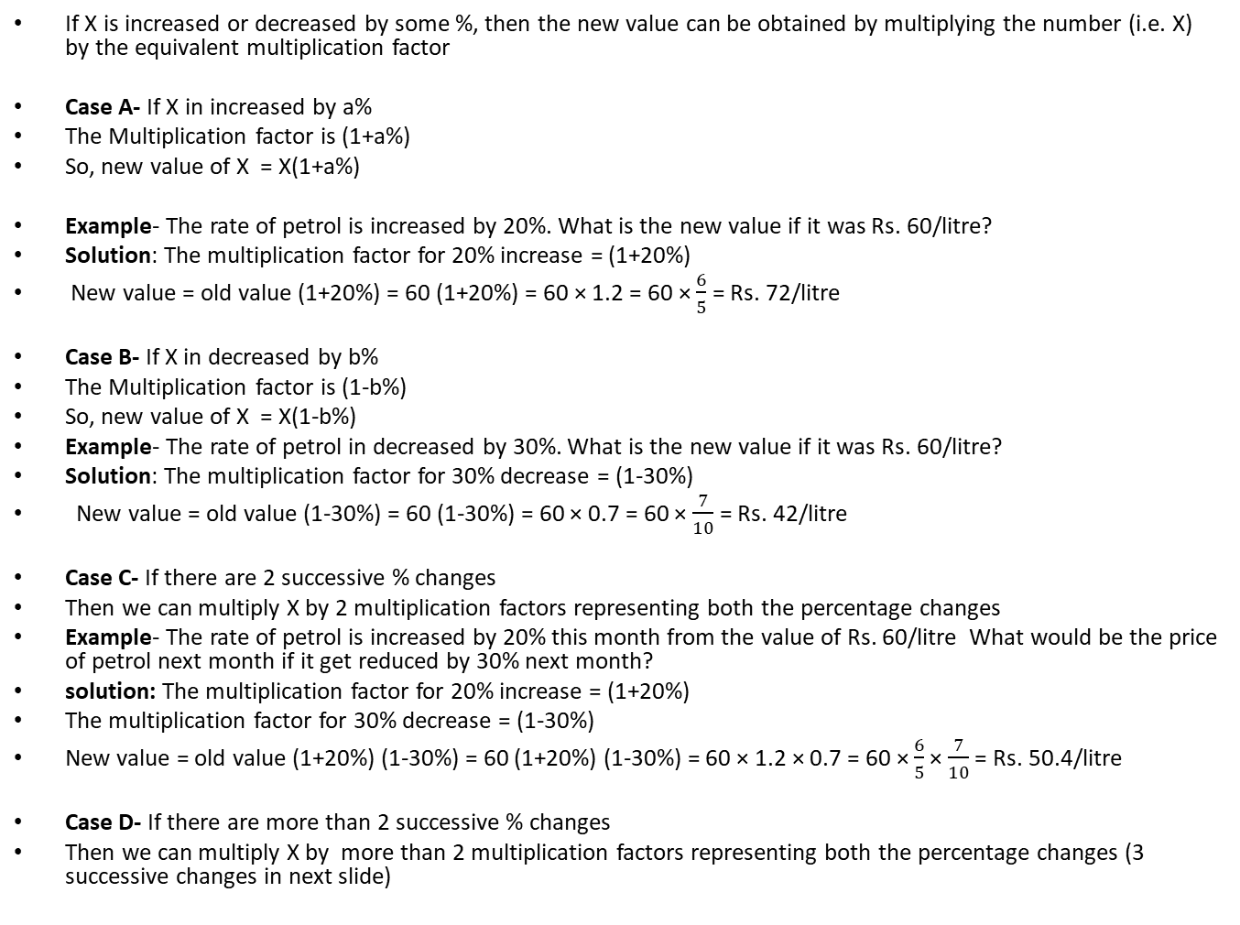
Multiplication Factor
If X is increased or decreased by some %, then the new value can be obtained by multiplying the number (i.e. X) by the equivalent multiplication factor
Case A- If X in increased by a%
The Multiplication factor is (1+a%)
So, new value of X = X(1+a%)
Example- The rate of petrol is increased by 20%. What is the new value if it was Rs. 60/litre?
Solution: The multiplication factor for 20% increase = (1+20%)
New value = old value (1+20%) = 60 (1+20%) = 60 × 1.2 = 60 × $\frac{6}{5}$ = Rs. 72/litre
Case B- If X in decreased by b%
The Multiplication factor is (1-b%)
So, new value of X = X(1-b%)
Example- The rate of petrol in decreased by 30%. What is the new value if it was Rs. 60/litre?
Solution: The multiplication factor for 30% decrease = (1-30%)
New value = old value (1-30%) = 60 (1-30%) = 60 × 0.7 = 60 × $\frac{7}{10}$ = Rs. 42/litre
Case C- If there are 2 successive % changes
Then we can multiply X by 2 multiplication factors representing both the percentage changes
Example- The rate of petrol is increased by 20% this month from the value of Rs. 60/litre What would be the price of petrol next month if it get reduced by 30% next month?
solution: The multiplication factor for 20% increase = (1+20%)
The multiplication factor for 30% decrease = (1-30%)
New value = old value (1+20%) (1-30%) = 60 (1+20%) (1-30%) = 60 × 1.2 × 0.7 = 60 × $\frac{6}{5}$× $\frac{7}{10}$ = Rs. 50.4/litre
Case D- If there are more than 2 successive % changes
Then we can multiply X by more than 2 multiplication factors representing both the percentage changes (3 successive changes in next slide)

Slide 25
Multiplication Factor to calculate % change for 2 or more successive changes
We can also use Multiplication factor to find % change too just like successive % change formula
Example 1: The rate of petrol was increased by 20% last month and it get reduced by 30% this month. What is the total % change?
Example 2: Let there be 3 successive changes in value of petrol were 20%, -30% and 40% respectively. The original price was Rs. 60/litre. What is the net % change?
Approach: If we want to use Multiplication factor to find % change, we need to use initial value as 1(instead of old value of variable) and then we will multiply it by all the multiplication factors. And the value will give indication of net % change
Solution 1: The multiplication factor for 20% increase = (1+20%)
The multiplication factor for 30% decrease = (1-30%)
New value = old value (1+20%) (1-30%) = 1 (1+20%) (1-30%) = 1 × 1.2 × 0.7 = 0.84
So, net change is -16%
Solution 2: The 3 changes are +20% , -30% and 40%
The multiplication factor for 20% increase = (1+20%)
The multiplication factor for 30% decrease = (1-30%)
The multiplication factor for 40% increase = (1+40%)
New value = old value (1+20%) (1-30%) (1+40%)= 1 (1+20%) (1-30%) (1+40%)= 1 × 1.2 × 0.7 × 1.4 = 0.84 × 1.4 = 1.176
So, the net % change is +17.6%
Problem with this approach: We may get trapped in complicated calculations

Slide 26
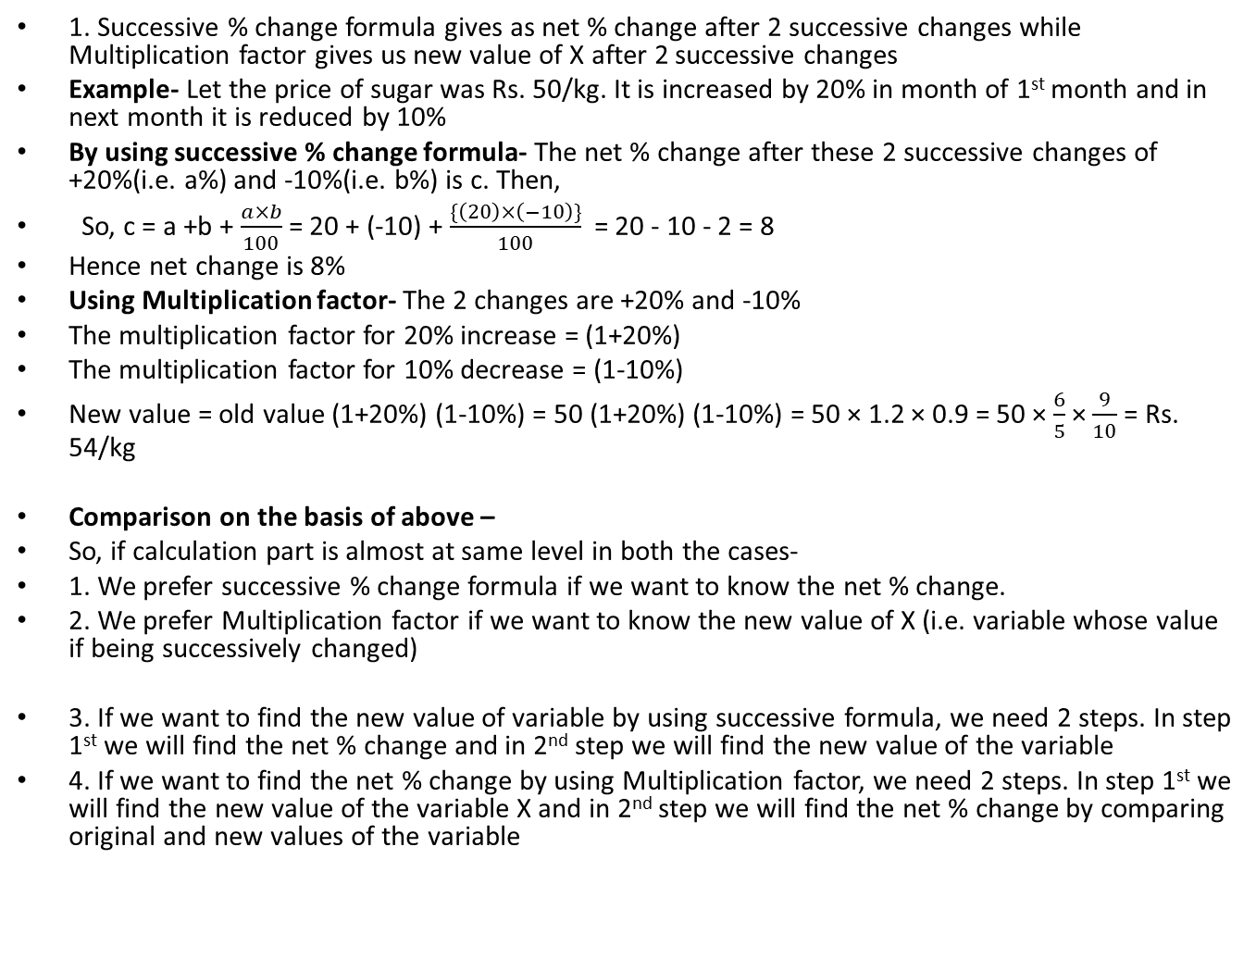
Successive percentage change formula VS Multiplication factor
1. Successive % change formula gives as net % change after 2 successive changes while Multiplication factor gives us new value of X after 2 successive changes
Example- Let the price of sugar was Rs. 50/kg. It is increased by 20% in month of 1st month and in next month it is reduced by 10%
By using successive % change formula- The net % change after these 2 successive changes of +20%(i.e. a%) and -10%(i.e. b%) is c. Then,
So, c = a +b + $\frac{a×b}{100}$ = 20 + (-10) + $\frac{\{\left(20\right)×\left(−10\right)\}}{100}$ = 20 - 10 - 2 = 8
Hence net change is 8%
Using Multiplication factor- The 2 changes are +20% and -10%
The multiplication factor for 20% increase = (1+20%)
The multiplication factor for 10% decrease = (1-10%)
New value = old value (1+20%) (1-10%) = 50 (1+20%) (1-10%) = 50 × 1.2 × 0.9 = 50 × $\frac{6}{5}$× $\frac{9}{10}$ = Rs. 54/kg
Comparison on the basis of above –
So, if calculation part is almost at same level in both the cases-
1. We prefer successive % change formula if we want to know the net % change.
2. We prefer Multiplication factor if we want to know the new value of X (i.e. variable whose value if being successively changed)
3. If we want to find the new value of variable by using successive formula, we need 2 steps. In step 1st we will find the net % change and in 2nd step we will find the new value of the variable
4. If we want to find the net % change by using Multiplication factor, we need 2 steps. In step 1st we will find the new value of the variable X and in 2nd step we will find the net % change by comparing original and new values of the variable

Slide 27
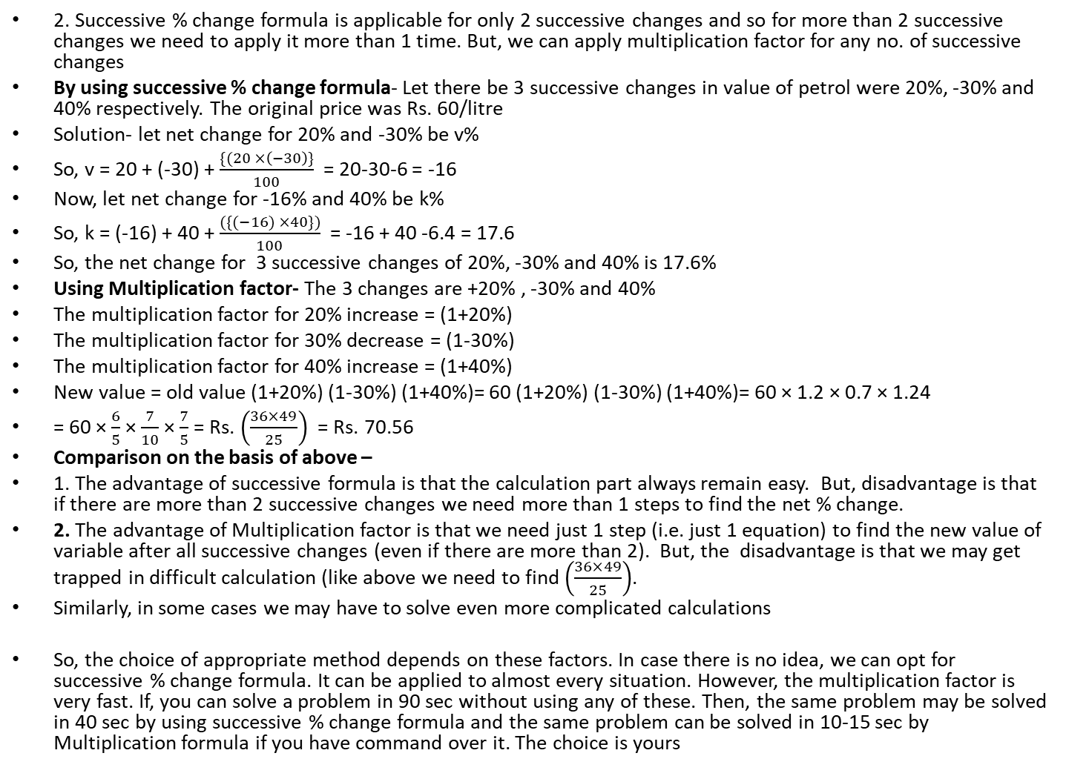
Successive percentage change formula VS Multiplication factor
2. Successive % change formula is applicable for only 2 successive changes and so for more than 2 successive changes we need to apply it more than 1 time. But, we can apply multiplication factor for any no. of successive changes
By using successive % change formula- Let there be 3 successive changes in value of petrol were 20%, -30% and 40% respectively. The original price was Rs. 60/litre
Solution- let net change for 20% and -30% be v%
So, v = 20 + (-30) + $\frac{\{(20 ×\left(−30\right)\}}{100}$ = 20-30-6 = -16
Now, let net change for -16% and 40% be k%
So, k = (-16) + 40 + $\frac{(\{(−16) ×40\})}{100}$ = -16 + 40 -6.4 = 17.6
So, the net change for 3 successive changes of 20%, -30% and 40% is 17.6%
Using Multiplication factor- The 3 changes are +20% , -30% and 40%
The multiplication factor for 20% increase = (1+20%)
The multiplication factor for 30% decrease = (1-30%)
The multiplication factor for 40% increase = (1+40%)
New value = old value (1+20%) (1-30%) (1+40%)= 60 (1+20%) (1-30%) (1+40%)= 60 × 1.2 × 0.7 × 1.24
= 60 × $\frac{6}{5}$× $\frac{7}{10}$ × $\frac{7}{5}$= Rs. $\left(\frac{36×49}{25}\right)$ = Rs. 70.56
Comparison on the basis of above –
1. The advantage of successive formula is that the calculation part always remain easy. But, disadvantage is that if there are more than 2 successive changes we need more than 1 steps to find the net % change.
2. The advantage of Multiplication factor is that we need just 1 step (i.e. just 1 equation) to find the new value of variable after all successive changes (even if there are more than 2). But, the disadvantage is that we may get trapped in difficult calculation (like above we need to find $\left(\frac{36×49}{25}\right)$.
Similarly, in some cases we may have to solve even more complicated calculations
So, the choice of appropriate method depends on these factors. In case there is no idea, we can opt for successive % change formula. It can be applied to almost every situation. However, the multiplication factor is very fast. If, you can solve a problem in 90 sec without using any of these. Then, the same problem may be solved in 40 sec by using successive % change formula and the same problem can be solved in 10-15 sec by Multiplication formula if you have command over it. The choice is yours

Slide 28
Multiplication Factor to calculate % change for 2 or more successive changes
We can also use Multiplication factor to find % change too just like successive % change formula
Example 1: The rate of petrol was increased by 20% last month and it get reduced by 30% this month. What is the total % change?
Example 2: Let there be 3 successive changes in value of petrol were 20%, -30% and 40% respectively. The original price was Rs. 60/litre. What is the net % change?
Approach: If we want to use Multiplication factor to find % change, we need to use initial value as 1(instead of old value of variable) and then we will multiply it by all the multiplication factors. And the value will give indication of net % change
Solution 1: The multiplication factor for 20% increase = (1+20%)
The multiplication factor for 30% decrease = (1-30%)
New value = old value (1+20%) (1-30%) = 1 (1+20%) (1-30%) = 1 × 1.2 × 0.7 = 0.84
So, net change is -16%
Solution 2: The 3 changes are +20% , -30% and 40%
The multiplication factor for 20% increase = (1+20%)
The multiplication factor for 30% decrease = (1-30%)
The multiplication factor for 40% increase = (1+40%)
New value = old value (1+20%) (1-30%) (1+40%)= 1 (1+20%) (1-30%) (1+40%)= 1 × 1.2 × 0.7 × 1.4 = 0.84 × 1.4 = 1.176
So, the net % change is +17.6%
Problem with this approach: We may get trapped in complicated calculations
For example if 3 changes are 13% increase, 23 % decrease and 19 % increase
Net % change in this case can be obtained as
New value = old value (1+13%) (1-23%) (1+19%)= 1 × 1.13 × 0.77 × 1.19
This calculation is very complicated and cumbersome.
So, we normally try to avoid using Multiplication factor for % change

Slide 29


Arrow method
We can use arrow method to find net % change or the changed value of a variable
Example- Let the price of sugar was Rs. 50/kg. It is increased by 20% in month of 1st month and in next month it is reduced by 10%
What is the net % change and final value?
Approach:
1. To find % change by using arrow method
Let initial value be 100 and then we can find net changes as shown below
So, net change is +8%
2. To find the final value
We will use arrow method with initial value as shown below
So, the final price of sugar is Rs. 54/kg

Slide 30
Positive and negative aspects of Arrow method
Positives of Arrow method
It can help us to find required % change or changed value of variable by a single arrow diagram
Negatives of Arrow method
We need to do calculation at every step and sometimes we may get trapped in tedious and complicated calculations
Applications- We can use this method if calculation is easy or if we are good in calculation part (like can change multiplication to addition
Example: Let there be 3 successive changes in value of petrol were 20%, -30% and 40% respectively. The original price was Rs. 60/litre. What is the net % change?
The 3rd calculation part is little difficult i.e. 84 × 1.4
SO, we can do it like this: 84 + 4(8.4) = 84 + 33.6 = 117.6
If we can use this type of approach in calculations, Arrow method can be used. Otherwise, we should avoid its use

Slide 31
Applications of Successive % change formula and Multiplication factor in other topics
1. Successive % change formula is useful to solve problems based on compound interest
2. Multiplication factor and successive % change formula are used in problems of profit and loss
3. Both of these methods are very useful in problems of Data Interpretation.
4. Similarly both of these are also used to some extent in other areas of Quantitative Aptitude
So, proper understanding of these 2 concepts is very essential for Quantitative Aptitude

Slide 32
Problems on successive % change formula and Multiplication factor
1. If all the mentioned values are increases, which among the following will lead to the maximum percentage change?
10%, 10% b. 19%, 1% c. 17%, 3%d. All of Them are equal
2. The price of petrol was first increased by 40% in the month of November and subsequently decreased by 25% in the month of December. If the Price after the decrease in December was Rs.63, find the Price of Petrol before the increase in November?
70 b. 55 c. 57 d. 60
3. The Salary of a man increased by 20% in the month of August and 5 % in the month of September. By what % is the Salary in October more than that in July of the same year?
a. 25% b. 26% c. 15% d. 1%

Slide 33
Solutions
1. If all the mentioned values are increases, which among the following will lead to the maximum percentage change?
a. 10%, 10% b. 19%, 1% c. 17%, 3% d. All of Them are equal
Solution 1:
2. The price of petrol was first increased by 40% in the month of November and subsequently decreased by 25% in the month of December. If the Price after the decrease in December was Rs.63, find the Price of Petrol before the increase in November?
70 b. 55 c. 57 d. 60
Solution 2:

Slide 34
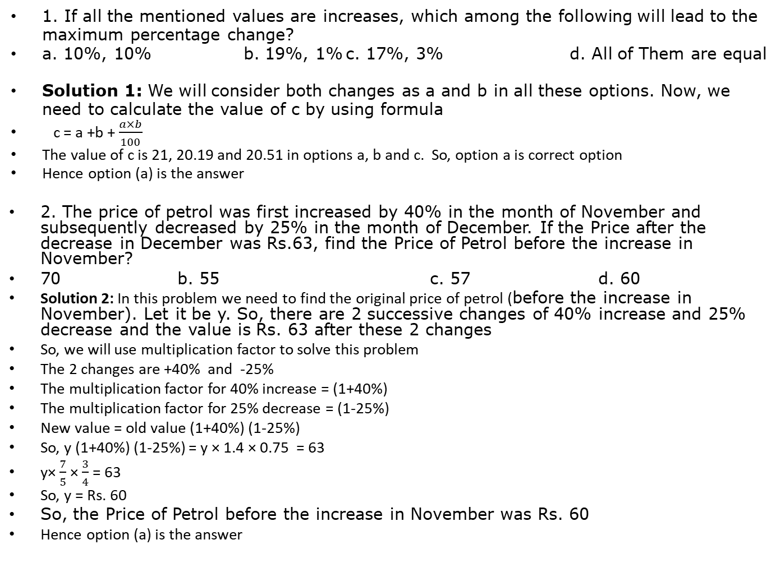
Solutions
1. If all the mentioned values are increases, which among the following will lead to the maximum percentage change?
a. 10%, 10% b. 19%, 1% c. 17%, 3% d. All of Them are equal
Solution 1: We will consider both changes as a and b in all these options. Now, we need to calculate the value of c by using formula
c = a +b + $\frac{a×b}{100}$
The value of c is 21, 20.19 and 20.51 in options a, b and c. So, option a is correct option
Hence option (a) is the answer
2. The price of petrol was first increased by 40% in the month of November and subsequently decreased by 25% in the month of December. If the Price after the decrease in December was Rs.63, find the Price of Petrol before the increase in November?
70 b. 55 c. 57 d. 60
Solution 2: In this problem we need to find the original price of petrol (before the increase in November). Let it be y. So, there are 2 successive changes of 40% increase and 25% decrease and the value is Rs. 63 after these 2 changes
So, we will use multiplication factor to solve this problem
The 2 changes are +40% and -25%
The multiplication factor for 40% increase = (1+40%)
The multiplication factor for 25% decrease = (1-25%)
New value = old value (1+40%) (1-25%)
So, y (1+40%) (1-25%) = y × 1.4 × 0.75 = 63
y× $\frac{7}{5}$× $\frac{3}{4}$ = 63
So, y = Rs. 60
So, the Price of Petrol before the increase in November was Rs. 60
Hence option (a) is the answer

Slide 35
Solutions
3. The Salary of a man increased by 20% in the month of August and 5 % in the month of September. By what % is the Salary in October more than that in July of the same year?
a. 25% b. 26% c. 15% d. 1%
Solution 3:

Slide 36
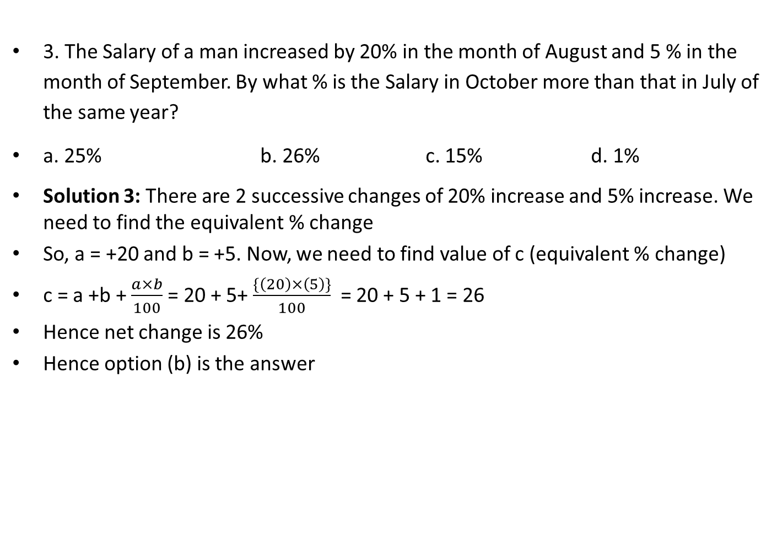
Solutions
3. The Salary of a man increased by 20% in the month of August and 5 % in the month of September. By what % is the Salary in October more than that in July of the same year?
a. 25% b. 26% c. 15% d. 1%
Solution 3: There are 2 successive changes of 20% increase and 5% increase. We need to find the equivalent % change
So, a = +20 and b = +5. Now, we need to find value of c (equivalent % change)
c = a +b + $\frac{a×b}{100}$ = 20 + 5+ $\frac{\{\left(20\right)×\left(5\right)\}}{100}$ = 20 + 5 + 1 = 26
Hence net change is 26%
Hence option (b) is the answer

Slide 37
Product based problems
Let, A be a numerical quantity which is obtained by multiplying 2 or more numerical quantities
Area of rectangle = Length × Breadth
Volume of a cuboid = Length × Breadth × Height
Expenditure (on a commodity) = Price per unit × Quantity
And similarly we can see many other examples too.
In all such cases we can say,
A = P × Q × R… etc
Now, we need to find the % change in value of A if there is some % change in 1 or more numerical quantities whose product gives us A
Now, product based problems are mainly of 2 types-
Type 1. To find change in value of product i.e. Mensuration based- In these types of problems we need to find the total change in area or volume by using the changes in length, breadth, height, radius etc.
Example-
1. What is % change in area of a circle if radius is increased by 20%?
2. what is the % change in the volume of a cuboid if length and breadth are increased by 10% while the height is decreased by 20%?
Type 2. If product remains constant like expenditure based problems
Example –
A. Expenditure based problems- In these problems we try to keep net expenditure on a commodity same irrespective the change in price or quantity by changing the quantity or price
1. By what % the consumption of petrol must be reduced so that expenditure on petrol remains same if price is increased by 20%?
2. If price of petrol is decreased by 20%, how much % more quantity can be used so that expenditure remains same?
Other examples of product to remain constant
1. the height of a cuboid is increased by 20%. By, what % we must reduce the length so that volume remains same if breadth is constant?

Slide 38
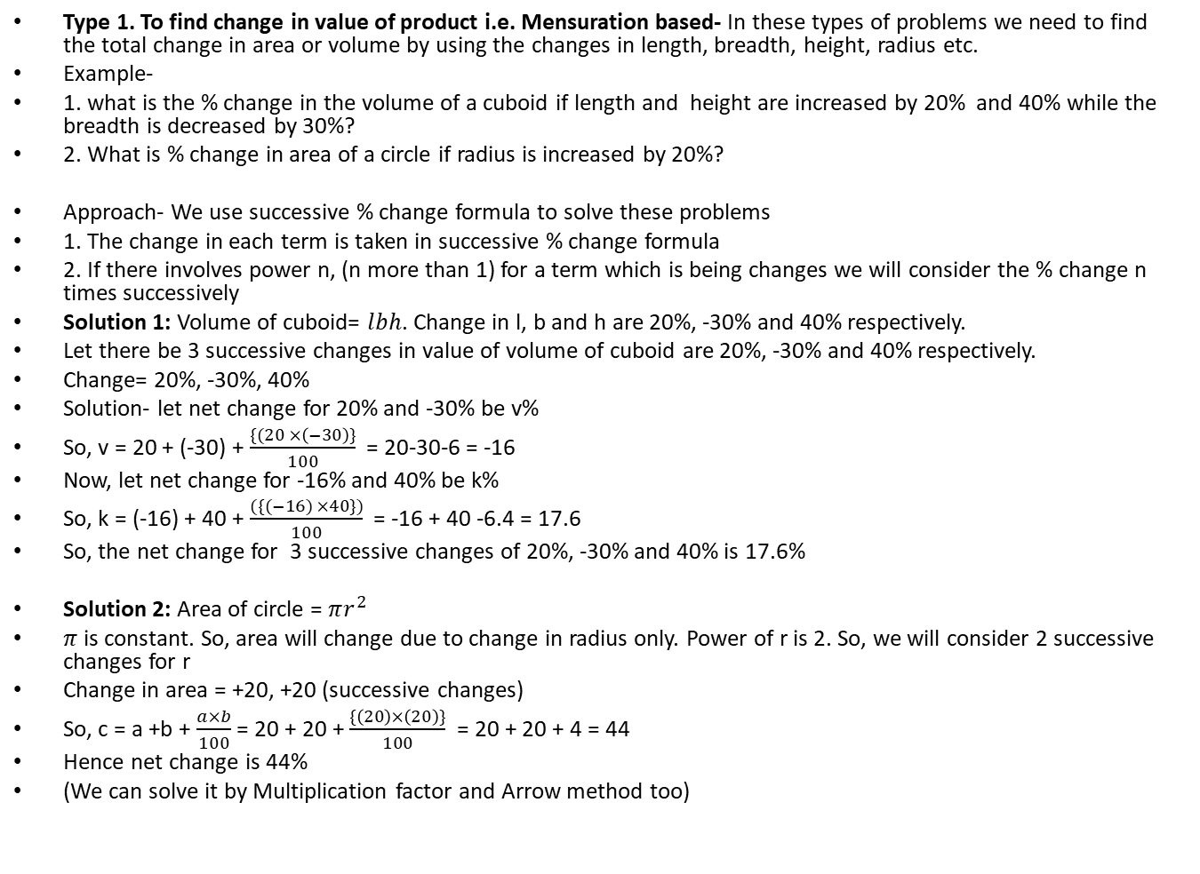
Solving Product based problems
Type 1. To find change in value of product i.e. Mensuration based- In these types of problems we need to find the total change in area or volume by using the changes in length, breadth, height, radius etc.
Example-
1. what is the % change in the volume of a cuboid if length and height are increased by 20% and 40% while the breadth is decreased by 30%?
2. What is % change in area of a circle if radius is increased by 20%?
Approach- We use successive % change formula to solve these problems
1. The change in each term is taken in successive % change formula
2. If there involves power n, (n more than 1) for a term which is being changes we will consider the % change n times successively
Solution 1: Volume of cuboid= $lbh$. Change in l, b and h are 20%, -30% and 40% respectively.
Let there be 3 successive changes in value of volume of cuboid are 20%, -30% and 40% respectively.
Change= 20%, -30%, 40%
Solution- let net change for 20% and -30% be v%
So, v = 20 + (-30) + $\frac{\{(20 ×\left(−30\right)\}}{100}$ = 20-30-6 = -16
Now, let net change for -16% and 40% be k%
So, k = (-16) + 40 + $\frac{(\{(−16) ×40\})}{100}$ = -16 + 40 -6.4 = 17.6
So, the net change for 3 successive changes of 20%, -30% and 40% is 17.6%
Solution 2: Area of circle = $πr^{2}$
$π$ is constant. So, area will change due to change in radius only. Power of r is 2. So, we will consider 2 successive changes for r
Change in area = +20, +20 (successive changes)
So, c = a +b + $\frac{a×b}{100}$ = 20 + 20 + $\frac{\{\left(20\right)×\left(20\right)\}}{100}$ = 20 + 20 + 4 = 44
Hence net change is 44%
(We can solve it by Multiplication factor and Arrow method too)

Slide 39
Type 2. If product remains constant like expenditure based problems
Example –
A. Expenditure based problems- In these problems we try to keep net expenditure on a commodity same irrespective the change in price or quantity by changing the quantity or price
1. By what % the consumption of petrol must be reduced so that expenditure on petrol remains same if price is increased by 20%?
2. If price of petrol is decreased by 20%, how much % more quantity can be used so that expenditure remains same?
Other examples of product to remain constant
1. the height of a cuboid is increased by 20%. By, what % we must reduce the length so that volume remains same if breadth is constant
Approach- These type of problems use concepts of base change and fraction equivalent of %
We will see approach by taking solution of example 1
Solution 1: In example 1 if we assume that price is increased by 20% for any commodity then the net expenditure must also increase by 20%. Hence the expenditure must be increased by 20%.
We need to find % change and so we do not need exact value of original expenditure. So, we can assume initial value of expenditure to be Rs. 100. So, with 20% increase in price of commodity, the price of expenditure will be Rs. 120 if consumption remains same
If we want the expenditure to remain same, it must be reduced by Rs. 20 from Rs. 120. So, net % change in consumption will be (20/120)× 100% = 16.66%

Slide 40
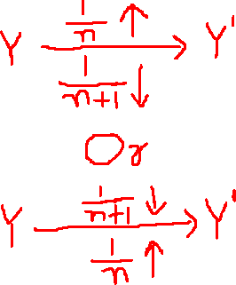

Very important approach to solve the expenditure based problems
We can see above if Y is net expenditure (or product) which should remain constant inspite of increase or decrease of price (or quantity)
So, the increase is $\frac{1}{n}$ in terms of fraction in price of a commodity (i.e. $\frac{1}{n}$ is the fraction equivalent of % increase in price), then the required decrease in quantity of commodity must be $\frac{1}{n+1}$ in terms of fraction (i.e. $\frac{1}{n+1}$ is the fraction equivalent of % decrease in commodity)
Similarly, if price is decreased and the decrease is $\frac{1}{n+1}$ in terms of fraction in price of a commodity (i.e. $\frac{1}{n+1}$ is the fraction equivalent of % decrease in price), then the required increase in quantity of commodity must be $\frac{1}{n}$ in terms of fraction (i.e. $\frac{1}{n}$ is the fraction equivalent of % increase in commodity)
Example- Let the price is increased by 25% for a commodity what is the required % decrease in consumption of commodity so that expenditure remains same?
Solution: 25% = $\frac{1}{4}$. So, the increase is ¼ i.e. n is 4. Hence, the required % decrease in consumption must be $\frac{1}{n+1}$ i.e. $\frac{1}{5}$ which is 20%

Slide 41
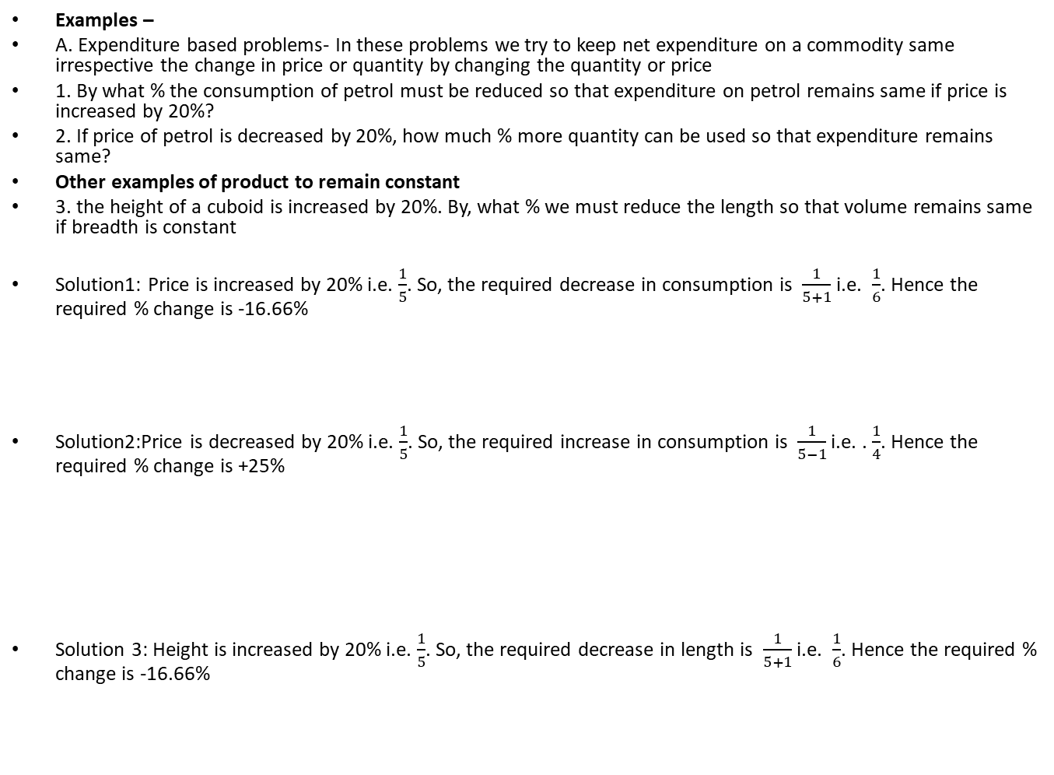
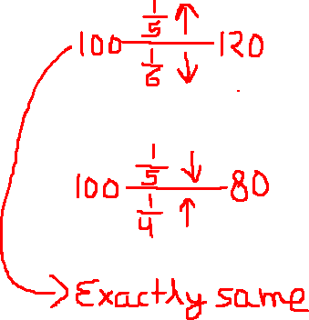
Type 2. If product remains constant like expenditure based problems
Examples –
A. Expenditure based problems- In these problems we try to keep net expenditure on a commodity same irrespective the change in price or quantity by changing the quantity or price
1. By what % the consumption of petrol must be reduced so that expenditure on petrol remains same if price is increased by 20%?
2. If price of petrol is decreased by 20%, how much % more quantity can be used so that expenditure remains same?
Other examples of product to remain constant
3. the height of a cuboid is increased by 20%. By, what % we must reduce the length so that volume remains same if breadth is constant
Solution1: Price is increased by 20% i.e. $\frac{1}{5}$. So, the required decrease in consumption is $\frac{1}{5+1}$ i.e. $\frac{1}{6}$. Hence the required % change is -16.66%
Solution2:Price is decreased by 20% i.e. $\frac{1}{5}$. So, the required increase in consumption is $\frac{1}{5−1}$ i.e. . $\frac{1}{4}$. Hence the required % change is +25%
Solution 3: Height is increased by 20% i.e. $\frac{1}{5}$. So, the required decrease in length is $\frac{1}{5+1}$ i.e. $\frac{1}{6}$. Hence the required % change is -16.66%

Slide 42
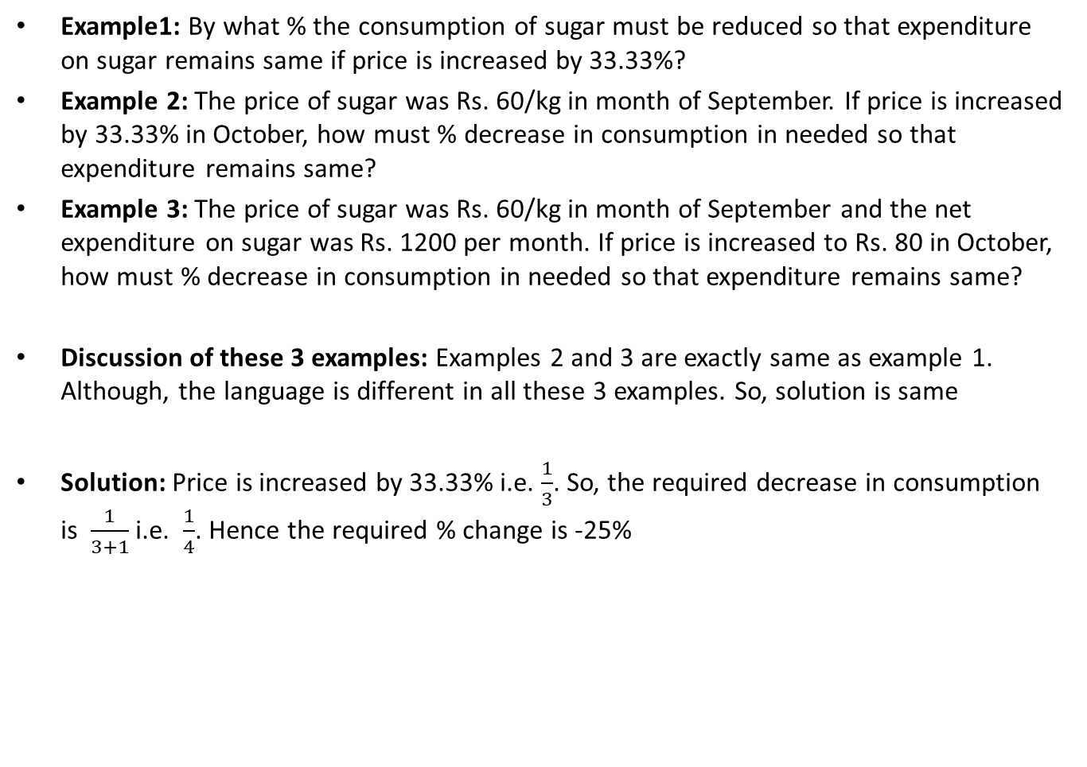
Different ways of asking same problem (expenditure based problems)
Example1: By what % the consumption of sugar must be reduced so that expenditure on sugar remains same if price is increased by 33.33%?
Example 2: The price of sugar was Rs. 60/kg in month of September. If price is increased by 33.33% in October, how must % decrease in consumption in needed so that expenditure remains same?
Example 3: The price of sugar was Rs. 60/kg in month of September and the net expenditure on sugar was Rs. 1200 per month. If price is increased to Rs. 80 in October, how must % decrease in consumption in needed so that expenditure remains same?
Discussion of these 3 examples: Examples 2 and 3 are exactly same as example 1. Although, the language is different in all these 3 examples. So, solution is same
Solution: Price is increased by 33.33% i.e. $\frac{1}{3}$. So, the required decrease in consumption is $\frac{1}{3+1}$ i.e. $\frac{1}{4}$. Hence the required % change is -25%

Slide 43
Different ways of asking same problem (expenditure based problems)
Example1: By what % the consumption of sugar must be reduced so that expenditure on sugar remains 90% of original value if price is increased by 25%?
Example 2: The price of sugar was Rs. 60/kg in month of September. If price is increased by 25% in October, how must % decrease in consumption in needed so that expenditure becomes 90% of its original value?
Example 3: The price of sugar was Rs. 60/kg in month of September and the net expenditure on sugar was Rs. 1200 per month. If price is increased to Rs. 72 in October, how must % decrease in consumption in needed so that expenditure becomes Rs. 960?

Slide 44
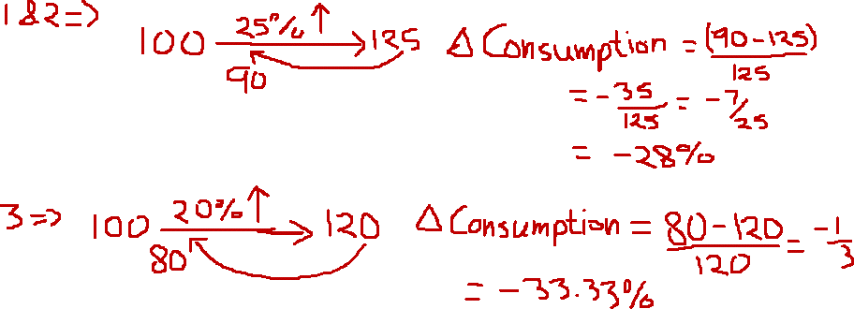
Different ways of asking same problem (expenditure based problems)
Example1: By what % the consumption of sugar must be reduced so that expenditure on sugar remains 90% of original value if price is increased by 25%?
Example 2: The price of sugar was Rs. 60/kg in month of September. If price is increased by 25% in October, how must % decrease in consumption in needed so that expenditure becomes 90% of its original value?
Example 3: The price of sugar was Rs. 60/kg in month of September and the net expenditure on sugar was Rs. 1200 per month. If price is increased to Rs. 72 in October, how must % decrease in consumption in needed so that expenditure becomes Rs. 960?

